Slide 1

SQL Server and JSON
It’s not a Horror Movie!

Slide 2
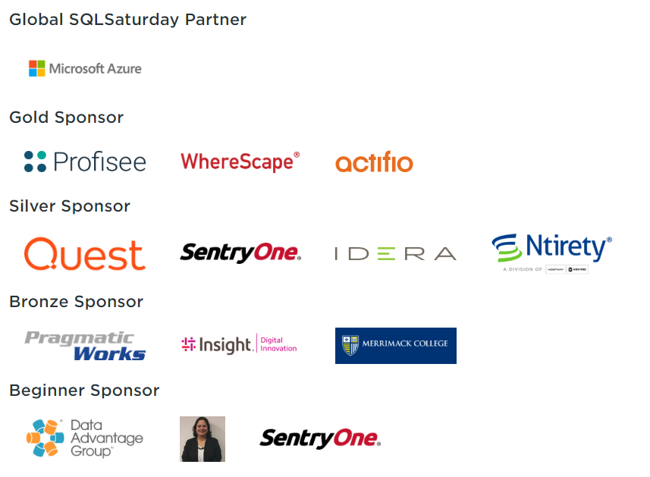
Thank You SQL Saturday 813 Boston BI Sponsors!

Slide 3
About Me
Business Intelligence and Integration Architect at Wellesley College
Oracle Database Design and Development – 30 years
SQL Server Database and Business Intelligence Stack – 5 years
8 Time SQL Saturday Boston Attendee
First Time Presenter
Email: adipesa@wellesley.edu
Twitter: @adipesa

Slide 4
AGENDA
What is JSON?
Why Use JSON with SQL Server?
SQL Server 2016 Support for JSON
Get JSON Formatted Data Into SQL Server Tables
Get Data Out from SQL Server Tables in JSON Format
Power BI Visualization of JSON Data

Slide 5

What is JSON?
JavaScript Object Notation
Lightweight Data Interchange Format
Facilitates Integration of Data Between Systems / Applications
Easy to Read and Write
Easy to Parse and Generate
Source: http://www.json.org/
Photo taken at Museum of Pop Culture – Seattle, WA

Slide 6
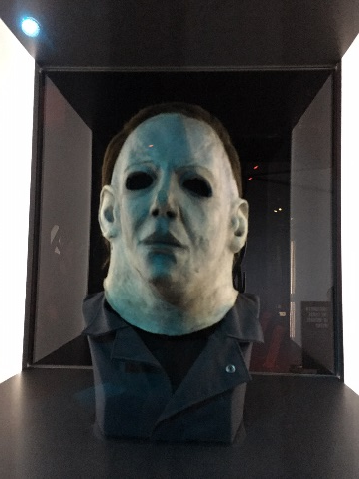
What is JSON?
Name / Value Pairs
{"title":"Scream","year":1996,"director":"Wes Craven"}
{"title":"Halloween","year":1978,"director":"John Carpenter"}
JSON Data Types
String, Number, Boolean (true or false), null
Array
"genre":["Horror", "Slasher"]
Object
"movie":{"MovieId":29213,"Title":"Friday the 13th","ReleaseYear":1980,"Director":"Sean S. Cunningham","CastListing":["Betsy Palmer", "Adrienne King", "Kevin Bacon"],"Genre":"Horror"}
Photo taken at Museum of Pop Culture – Seattle, WA

Slide 7
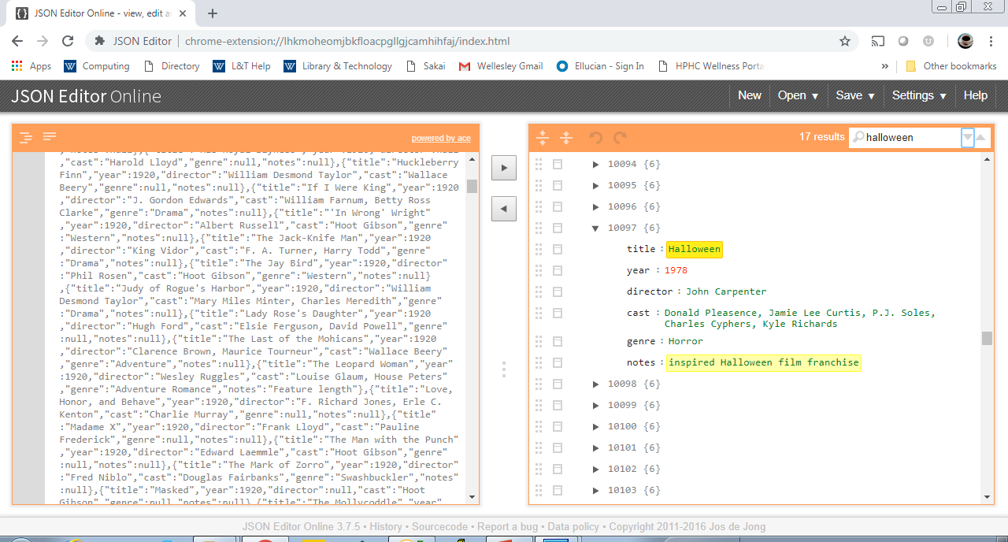
Movies JSON Data Set

Slide 8
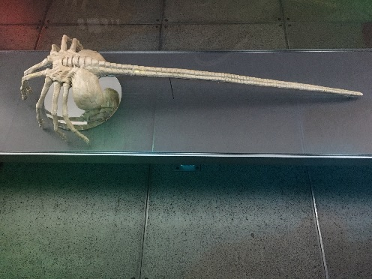
Why Use JSON with SQL Server?
Automate Data In to SQL Server from NoSQL Sources
Automate Data Out from SQL Server to NoSQL Sources
Integrate Data to / from Many Cloud-Based Services
Represents Nested Relationships Flexibly
More Compact and Readable than CSV and XML Formats
Photo taken at Museum of Pop Culture – Seattle, WA

Slide 9
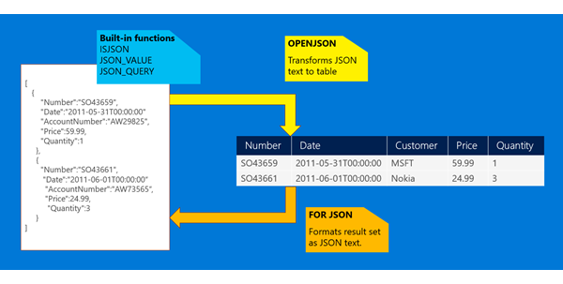
SQL Server 2016 Support for JSON
Source: https://docs.microsoft.com/en-us/sql/relational-databases/json/json-data-sql-server?view=sql-server-2017

Slide 10
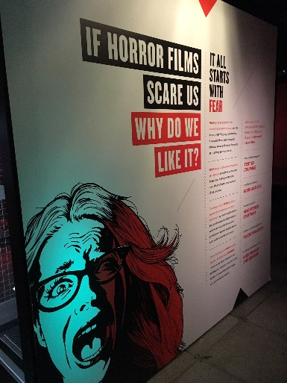
SQL Server 2016 Support for JSON
Facilitating Data In
ISJSON
OPENROWSET
OPENJSON
Note: No JSON-specific column data type. Use nvarchar(max)
Photo taken at Museum of Pop Culture – Seattle, WA
Facilitating Data Out
FOR JSON AUTO
FOR JSON PATH
FOR JSON PATH, ROOT
INCLUDE_NULL_VALUES
JSON_VALUE
JSON_QUERY

Slide 11
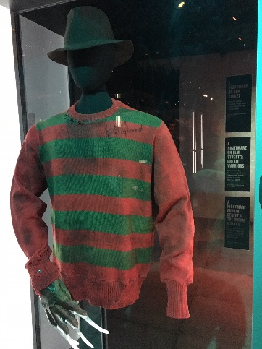
Get JSON Formatted Data Into SQL Server Tables
insert into dbo.MoviesJSON(MoviesJSON)
select MoviesData.*
from openrowset (bulk 'C:\Presentations\Boston Code Camp\wikipedia-movie-data-master\movies.json', single_clob) as MoviesData;
select ISJSON(MoviesJSON) IsJSON, MoviesJSON, len(MoviesJSON) as LengthMoviesJSON
from dbo.MoviesJSON;
Photo taken at Museum of Pop Culture – Seattle, WA

Slide 12

SQL Server 2016 – JSON In Demo
Image Source: Pixabay

Slide 13
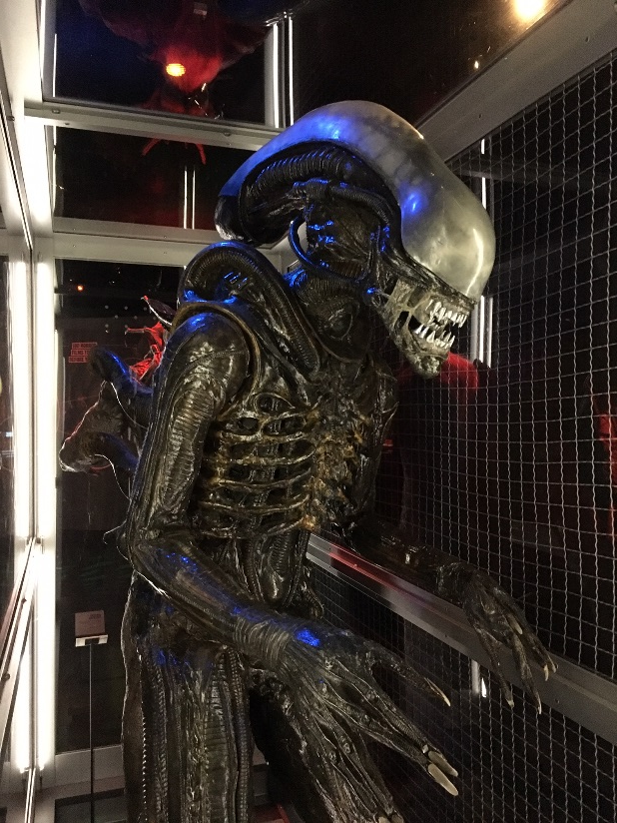
Get Data Out from SQL Server Tables in JSON Format
select *
from dbo.Movies
where Genre like '%Horror%'
FOR JSON PATH, ROOT('Movies');
select *
from dbo.Movies
where Genre like '%Horror%'
FOR JSON PATH, WITHOUT_ARRAY_WRAPPER;
Photo taken at Museum of Pop Culture – Seattle, WA

Slide 14

SQL Server 2016 – JSON Out Demo
Image Source: Pixabay

Slide 15

Power BI / JSON Data Visualization Demo
Image Source: Pixabay

Slide 16
Questions?

Slide 17
References
https://github.com/prust/wikipedia-movie-data
http://www.json.org/
https://docs.microsoft.com/en-us/sql/relational-databases/json/json-data-sql-server?view=sql-server-2017
https://www.red-gate.com/simple-talk/sql/learn-sql-server/json-support-in-sql-server-2016/
https://docs.microsoft.com/en-us/sql/relational-databases/json/solve-common-issues-with-json-in-sql-server?view=sql-server-2017
https://channel9.msdn.com/Shows/Data-Exposed/SQL-Server-2016-and-JSON-Support
https://channel9.msdn.com/Shows/Data-Exposed/Using-JSON-in-SQL-Server-2016-and-Azure-SQL-Database
https://channel9.msdn.com/events/DataDriven/SQLServer2016/JSON-as-a-bridge-betwen-NoSQL-and-relational-worlds

Slide 18
Thank You!
Contact Info:
Email: adipesa@wellesley.edu
Twitter: @adipesa

